Slide 1
Internetworking Technologies
Internetworking Devices - I (Hour-2) (EA ZC451)
Dr. Suvadip Batabyal
Dept. of CS&IS

Slide 2
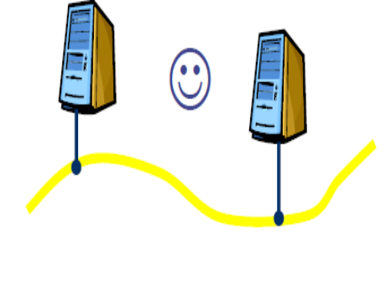
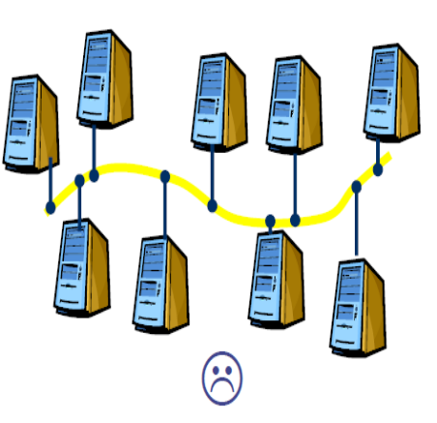
Introduction – Internetworking Devices
Network devices may not always be connected to the same medium.
Collision domain: A collision domain is a section of a network connected by a shared medium or through repeaters where data packets can collide with one another when being sent.
Devices connected to the same medium fall within the same collision domain.
Problems:
  Ethernet works fine when number of devices within a collision domain is small.
  Collapses when the number of devices is large.
  Networks are often heterogeneous.
  Geographic distribution of different groups over different buildings, campus, etc.
2 November 8, 2026 Dr. Suvadip Batabyal EA ZC451 Internetworking Technologies

Slide 3
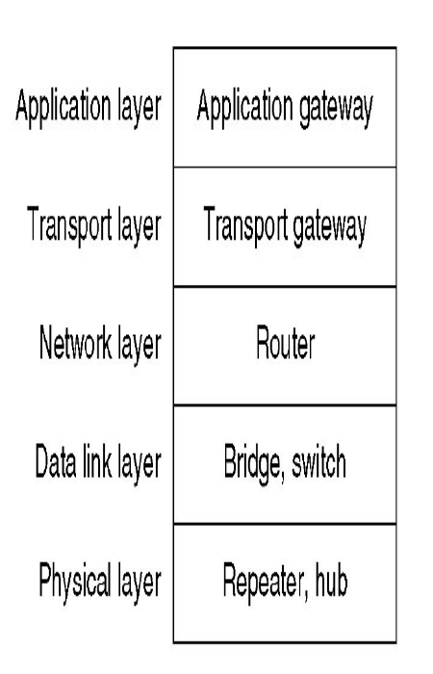
Internetworking Devices
Devices connect two or more networks of homogeneous or heterogeneous nature.
May (re)direct data to specific locations within the network.
May convert data into alternative formats.
Devices which operate at physical layer are more generally called connectivity devices and not internetworking devices.
3 November 8, 2026 Dr. Suvadip Batabyal EA ZC451 Internetworking Technologies

Slide 4
Internetworking Devices
Physical Layer:
  Repeater: It is a connectivity device which is used to regenerate and amplify weak signals, thus extending the length of the network. Repeaters perform no other action on the data.
  Hub: Also known as concentrator. Hubs reside in the core of the LAN cabling system. The hub connects workstations and sends every transmission to all the connected workstations.
Data Link Layer:
  Bridge: used to connect two or more network (segments) which obey same network layer protocol.
  Switch: is same as bridge except that it connects to terminals or workstations instead of networks.
Network Layer
  Router: Connects two or more networks in an internet. Can interconnect dissimilar LANs or networks.’
Gateway: is used to connect multiple networks and passes packets from one network to the other network. It is used to segregate two different networks often having different policies and security features.
4 November 8, 2026 Dr. Suvadip Batabyal EA ZC451 Internetworking Technologies

Slide 5
Repeaters
Is a device which receives signal and retransmits it after:
  Reducing noise (component)
  Amplifying the signal
Is used to extend transmission so that signals can cover longer distance.
Power of a signal diminishes as it travels over longer distances. Hence difficult to hear at the receiver side.
Noise component is introduced. Hence, difficult to decode at the receiver side.
Repeaters may come as separate device or may be incorporated in the hub. Such hubs are known as the Active Hub.
Do not process or make changes on the packets.
5 November 8, 2026 Dr. Suvadip Batabyal EA ZC451 Internetworking Technologies

Slide 6
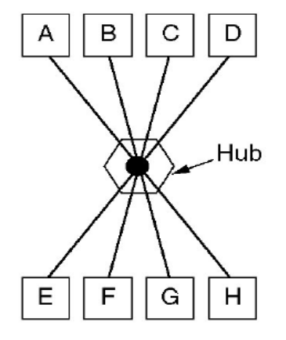
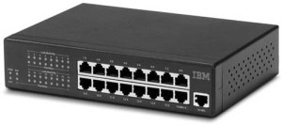
Hubs
HUB is used to connect multiple computers in a single workgroup LAN network.
Copies incoming data (bits) to all the ports except from which it came.
Typically hubs are available with 4, 8, 12, 24, and 48 ports all having RJ-45 connectors.
Two types of hubs:
  Passive: It doesn’t interfere with incoming data signal. Simply forwards
  data to all outgoing ports.
  Active: has inbuilt repeater. Hence improves signal quality before forwarding it.
6 20 July 2017 Dr. Suvadip Batabyal EA ZC451 Internetworking Technologies

Slide 7
Bridge
To improve the performance of a network, it may be divided into smaller segments.
Join different media types such as UTP with fiber optic.
Join different network architectures such as Ethernet with Token Ring.
Each network connected to a bridge has separate collision domain.
A bridge inspects the incoming packet and forwards it to appropriate network.
7 November 8, 2026 Dr. Suvadip Batabyal EA ZC451 Internetworking Technologies

Slide 8
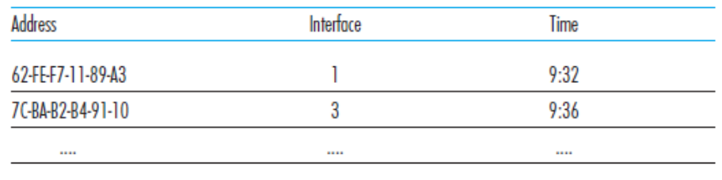
Switch
A (layer-2) switch is used to connect several terminals.
Forwards frames based on LAN destination using layer-2 address.
Can interconnect different LAN technologies like 10BaseT, 100BaseT, Gigabit Ethernet, etc.
Two important task of switch:
  Filtering: whether a frame should be forwarded or dropped.
  Forwarding: to which interface it should be directed.
Filtering and forwarding are done using switch table.
  A switch table contains MAC address of a node.
  Switch interface which leads to that node.
  Timestamp when that node entry was made in the switch table.
Ref. Computer Networking: A Top-Down Approach, Kurose & Ross, 6th Edition.
8 November 8, 2026 Dr. Suvadip Batabyal EA ZC451 Internetworking Technologies

Slide 9
Switch
Support three methods of switching:
  Store and Forward
  Cut and Through
  Fragment Free
Store & Forward: this is the basic mode of switching. Buffers entire frame into the memory, run FCS, length is valid and finally forwarded to appropriate interface buffer. Has the highest latency.
Cut & Through: has the lowest latency. Reads the destination address (first 6 bytes) and forwards without checking validity.
Fragment Free: combination of previous two. Checks first 64 bytes for errors. Forwards if no error.
9 November 8, 2026 Dr. Suvadip Batabyal EA ZC451 Internetworking Technologies

